Slide 1
SEO Planning- Customizing your Strategy

Slide 2
Topics Covered
Discuss strategic goals for SEO practitioners
Develop an SEO plan prior to site development
Understanding Your Audience and Finding Your Niche
Discuss SEO for raw traffic, eCommerce sales, direct marketing, and reputation management
Discuss SWOT Analysis for SEO Planning and Evaluation

Slide 3
Introduction
SEO, once a highly specialized and often marginalized task relegated to the back rooms of website development teams, is now a mainstream digital marketing activity.
SEO is a process—one that is iterative and ongoing, and requires steady commitment from the stakeholders of an organization.
The results may not appear instantly, but a business that makes a patient and prudent commitment to SEO, invests in quality content development, constructs a crawlable site architecture, and earns legitimate linking relationships will be handsomely rewarded.
Search engine optimization is a technical marketing function that relies upon both content creation and technological development.
SEO’s success in organic search greatly depends upon various technical and analytical tools that provide access to valuable data necessary for ongoing SEO and website improvement, as well as overall user experience optimization

Slide 4
Strategic Goals SEO Practitioners Can Fulfill (1)
Organic search, as a source of highly targeted traffic, is one of many viable online marketing channels. And while SEO is not a cure-all for businesses, it can fit into a company’s overall business strategy in several critical ways.
Visibility (Branding) : Many consumers assume that top placement in search engines is like a stamp of approval on a brand. Surely a company could not rank highly in search results if it were not one of the best in its field, right?
If you are an experienced search engine user, you probably recognize that the preceding statement is not always true.
However, the fact is that many consumers, and even sophisticated web searchers, interpret high search rankings as an implicit brand endorsement.
Therefore, for critical brand terms, an SEO strategy should be geared toward increasing organic search exposure for branded keywords.

Slide 5
Strategic Goals SEO Practitioners Can Fulfill (2)
Visibility (Branding): In addition to targeting brand terms, you will want to rank well for non branded search terms that are specific to your core business (a highly competitive, but highly rewarding, branding effort).
When searchers see you ranking highly on these types of search terms, they will associate your brand with the product or service and assume you are one of the best places to purchase from.
The list of situations where the brand can also limit the SEO strategy is quite long, and the opposite can happen too, where the nature of the brand makes a particular SEO strategy pretty compelling. Ultimately, your goal is to dovetail SEO efforts with branding as seamlessly as possible.

Slide 6
Strategic Goals SEO Practitioners Can Fulfill (3)
Website Traffic: Long gone are the days of a “build it and they will come” paradigm online.
Today’s search environment is highly competitive, and you need great SEO to capture targeted, high-quality traffic to your site.
While a business that engages with many of its customers through offline channels can drive traffic by telling those customers to visit its website, SEO fills the different, more critical role of bringing new prospects to your website from an audience of people who might not otherwise have been interested in, or perhaps even aware of, your business at all.

Slide 7
Strategic Goals SEO Practitioners Can Fulfill (4)
Website Traffic:
Experienced SEO professionals understand that users search for products, services, and information using an extraordinarily wide variety of search queries and query types.
Developing an SEO strategy involves performing extensive keyword research (discussed in next classes) to determine which search queries people actually use.
For example, when interested in purchasing a fuel-efficient car, a searcher might type in hybrid efficient cars.
In this instance, the search marketing manager for a manufacturer of electric cars might be interested in search exposure for this traffic, even though technically, electric cars was not in the original search query.

Slide 8
Strategic Goals SEO Practitioners Can Fulfill (5)
Website Traffic:
Some users may not even know that a company specializing in a specific type of product exists until they perform that search.
Or, if they have at one time learned about such a manufacturer, they might not remember enough about it to seek out the manufacturer’s website directly.
Capturing that traffic could provide the manufacturer with incremental sales of its electric vehicles that it probably would not have gotten otherwise.
Knowing these factors, the SEO process involves developing a site architecture strategy and a content development/editorial strategy (discussed in next chapters) to help the site’s pages achieve competitive search engine exposure for a broad range of potentially relevant terms.

Slide 9
Strategic Goals SEO Practitioners Can Fulfill (6)
High Return on Investment:
Increasing online visibility and driving targeted traffic are the first steps to success with SEO.
The next step is measuring the performance of that traffic to determine whether the overall website and business objectives are being achieved. This is an ongoing, iterative process that will always accompany all marketing efforts, and SEO is no exception.
For most organizations, goals are defined as generating sales, leads, or advertising revenue. For others, goals may include promoting a particular message; consuming, sharing, or perhaps creating specific types of content; or gaining simple signups for a newsletter.

Slide 10
Strategic Goals SEO Practitioners Can Fulfill (7)
High Return on Investment:.
An important component of SEO is to deliver not just traffic, but targeted traffic that has the potential to convert into these actions.
Whether you are selling products and services, advertising for branding value, or trying to promote specific content to the world, a well-designed SEO strategy can result in a very high return on investment (ROI) when contrasted with other methods of marketing.
SEO generally brings a higher ROI when compared to TV, print, and radio advertising campaigns; and while traditional media is not in danger of being replaced by SEO, organic search can provide some high-margin returns that complement and enhance the use of offline media—especially when done properly over the long haul

Slide 11
Every SEO Strategy Should Be Customized
There is no such thing as a cookie-cutter SEO strategy. The ever-changing, dynamic nature of the search marketing industry requires constant diligence, and SEO professionals must maintain a research process for analyzing how the search landscape is changing. You must take the following factors into account when developing your SEO strategy:
What the organization is trying to promote (service, product, content)
Who the target market is (can be as simple as “women” or as detailed as personas)
Brand (includes copy and messaging)
Website structure (includes site architecture, navigational elements, and file/URL naming conventions)
Current site content assets (includes images, videos, PDF files, white papers, case studies, articles)
Ease with which the content and site structure can be modified (involves the CMS and web development teams)
Editorial resources and calendar for content development (what content is developed, by whom, and on what timeline)
Competitive landscape

Slide 12
Understanding Your Audience and Finding Your Niche (1)
Your target audience should drive the initial site design, and should inform your SEO and content development strategies.
Mapping Your Products and Services : Successful SEO requires a thorough understanding of your business. What products, services, and types of information and resources do you have to offer your site visitors and potential customers?
A critical component of SEO is understanding who is searching for what you are trying to promote, and this requires thoroughly understanding all aspects of your offering.
You will need to understand both the broad and specific market categories that your products fall into, as each of these categories might relate to sections of your website that you will likely need to create.
By having content areas of the site for those categories, you create the opportunity to obtain organic search traffic related to those categories.

Slide 13
Understanding Your Audience and Finding Your Niche (2)
Mapping Your Products and Services : You also should consider business development and the company’s expansion strategy at the outset of the SEO planning process.
Consider Amazon, which began as a book- seller but has evolved into a general-purpose e-tailer; sites that go through these types of changes may need to be substantially restructured, and such restructurings can be a source of major SEO headaches.
Anticipating and planning for these types of changes in advance provides the opportunity to identify and execute appropriate architectural approaches to developing and optimizing the site.

Slide 14
Understanding Your Audience and Finding Your Niche (3)
Understanding That Content Is King : It has been debated since the late 1990s: whether content is king in SEO.
Not only is content king for SEO purposes, but as the main driver of engagement on the Web, it is also one of the most important elements of any online effort.
Development of high- quality, engaging content for your users increases the available real estate for organic search queries; provides your users reason to enjoy your site and compels them to become customers; and invites promotion and exposure through users sharing your content online, on social media platforms and via direct links from other websites.
Determining your available content assets is the first step toward leveraging them within the context of SEO.
You may have a deep library of “how to” content, great testimonial or product demonstration videos, a unique photo gallery, or an awesome tool that people are interested in using.
All of these content types can be invaluable in building a world-class website that does well in both search engines and the overall web ecosystem.

Slide 15
Understanding Your Audience and Finding Your Niche (4)
Understanding That Content Is King :
The content you have available to you will also affect your keyword research and your site architecture, as your content is the major source of information that search engines use to determine what your site is about.
Content marketing can be very similar to PR in that the success of your efforts is integrally related to what you are promoting (i.e., what type of content, and of what quality, are you hoping others will link to?).

Slide 16
Understanding Your Audience and Finding Your Niche (5)
Understanding That Content Is King :
Consider Site A, a site that has built a substantial, well-researched and well-written set of articles on a specific topic.
However, 20 other sites out there have equally substantial sets of articles on the same topic, and many of these other sites have been in the major search engine indexes for much longer than Site A.
Site A has a content quality concern—namely, why would someone link to its articles over the articles from any of the other 20 websites? There is nothing new there.
Chances are that Site A will succeed in getting some links to its articles; however, it will likely never be able to establish itself as a leader if it has nothing new or unique to offer.

Slide 17
Understanding Your Audience and Finding Your Niche (6)
Understanding That Content Is King :
To establish itself as a leader, Site A must create fresh, unique, engaging content that differentiates the site from its competitors.
Perhaps it can offer a solution to a problem that no one else has been able to solve before, or perhaps it focuses on a specific vertical niche and establishes itself as a leader in that niche—for example, by being the first to release a high-quality video series on the topic it covers.
One of the most important decisions Site A’s leadership needs to make is where and how they are going to establish themselves as an authoritative resource in their industry.
If they plan to make their website a major player in capturing market-related search engine traffic, this is not an optional step.

Slide 18
Understanding Your Audience and Finding Your Niche (7)
Understanding That Content Is King :
When looking at content plans and hopefully establishing an editorial calendar, it is critical to consider not only what you already have, but also what you could develop. This, of course, relates to budget.
A publisher with no budget to spend on content development has few choices that she can make in her SEO strategy, whereas another publisher who has a team of in-house content developers has a myriad of options.

Slide 19
Understanding Your Audience and Finding Your Niche (8)
Segmenting Your Site’s Audience: Let’s not forget the audience! It is important for the SEO practitioner to understand the target audience.
For example, Site A may be a website that sells sneakers.
As a result, the site’s developers go out and implement a brilliant campaign to rank for the “sneaker” terms they consider relevant. Being young and energetic, they focus on the way their peers search for sneakers—but what if the target audience for the sneakers Site A sells are age 50 or older?
This segmentation goes to the very core of deciding what pages to create on your site, and what content to put on them.

Slide 20
Understanding Your Audience and Finding Your Niche (9)
Segmenting Your Site’s Audience: The target audience for Site A (the over-50 crowd) may use different search terms than the younger generation to search for sneakers, which means Site A may well be bringing in search traffic from people who are not interested in its products, and not bringing in traffic from those who might be!
For example, Skechers, a California-based shoe company, made the business decision to pivot from being a youth brand to targeting an older demographic with their shoes—so an SEO strategy for selling Skechers sneakers at this stage, then, would be very different from an SEO strategy for the more youth-oriented Nike sneakers.

Slide 21
SEO for Raw Traffic (1)
Optimizing for search engines and creating thematically targeted content helps a site rank for key search queries, which typically leads to direct traffic, social sharing, and referral traffic from links as more and more people find, use, and enjoy the content you’ve produced.
Thousands of sites on the Web leverage this traffic to serve advertising, directly monetizing the traffic sent from the engines.
From banner ads to contextual services such as Google’s AdSense, to affiliate and social media marketing, Internet advertising spending has become a massive industry.
In October 2014, the Internet Advertising Bureau measured Internet advertising revenues for Q3 2014 at $12.4 bil- lion, a 17% increase over Q4 2013.1

Slide 22
SEO for Raw Traffic (2)
Here are some factors to think about when considering SEO for raw traffic:
When to employ SEO for raw traffic
Use it when you can monetize traffic without actions or financial transactions tak- ing place on your site (usually through advertising).
Keyword targeting
Keyword targeting in this scenario can be very broad. The goal here isn’t typically to select specific keywords, but rather to create high-quality content that naturally targets interesting, searched-for terms.
Instead of singular optimization on specific terms, the focus is on accessibility and best practices throughout the site to earn traffic through both high-volume and long-tail queries.
Concentrate efforts on great content, and use keyword- based optimization as a subsequent application to confirm the titles, headlines, filenames, metadata, and other elements of the content you create.

Slide 23
SEO for Raw Traffic (3)
Here are some factors to think about when considering SEO for raw traffic:
Page and content creation/optimization
A shallow, highly crawlable link structure is critical to getting all of your content indexed—follow good information architecture practices and use intelligent, detailed category and subcategory structures to get the most benefit out of your work.
You’ll also need to employ good on-page optimization in <title> tags, headlines, internal links, and so on, and make your articles easy to share and optimized for viral spreading

Slide 24
SEO for Ecommerce Sales (1)
One of the most direct monetization strategies for SEO is driving relevant traffic to an ecommerce shop to boost sales. Search traffic is among the highest quality traffic on the Web, primarily because a search user has expressed a specific interest through his query, and when this matches a service, product, or brand a website carries, conversion rates are often extremely high.
Here are some factors to think about when considering SEO for ecommerce sales:
When to employ SEO for ecommerce sales
Use it when you have products/services that are directly for sale on your website.

Slide 25
SEO for Ecommerce Sales (2)
Here are some factors to think about when considering SEO for ecommerce sales:
Keyword targeting
PPC advertising is an excellent way to test the efficacy and potential ROI of key- word targets.
Find those that have reasonable traffic and convert well, and pursue them further.
You’ll often find that the more specific the query is—brand- inclusive, product-inclusive, and so on—the more likely visitors are to make the purchase.
The best use of this tactic is for generic terms that you will find harder to win on than brand/company named terms, so you can decide if they are worth the effort.

Slide 26
SEO for Ecommerce Sales (3)
Here are some factors to think about when considering SEO for ecommerce sales:
Quality content creation and optimization
Your site will need to provide interesting, unique, and accessible content for both users and search engines in order to begin gaining traction in organic search.
The links and social sharing that come from such content are highly influential in increasing overall site traffic, as well as improving organic search performance.
Creating link-worthy, deeply engaging content should be the primary focus of any website seeking search and referral traffic, and should be incorporated into both the content development and SEO strategies.
Manual link building is always an option, but scalable strategies that leverage a community or customers can be equally, or even more, valuable.
Remember: content that keeps users on the page, instead of prompting them to click away rapidly, is a signal of quality and also serves to increase the value of traffic to the page (improving page monetization through advertising)

Slide 27
SWOT Analysis (1)
There are many methodologies for business planning. One of the better-known ones is the SWOT (strengths, weaknesses, opportunities, threats) analysis.
There are also methodologies for ensuring that the plan objectives are the right type, such as the SMART (specific, measurable, achievable, realistic, timelined) plan. We will take a look in SWOT Analysis in this Class.
SWOT Analysis : Sometimes you need to get back to the basics and carry out a simple evaluation of where you are in the marketplace, as well as where you would like to be; for this, a SWOT analysis is a great starting point. It creates a grid from which to work and is very simple to execute.
As you can see from the SWOT chart in Figure 3-3, strengths and weaknesses usually stem from internal (on-site, business operational, business resource) sources, whereas opportunities and threats are from external sources.

Slide 28
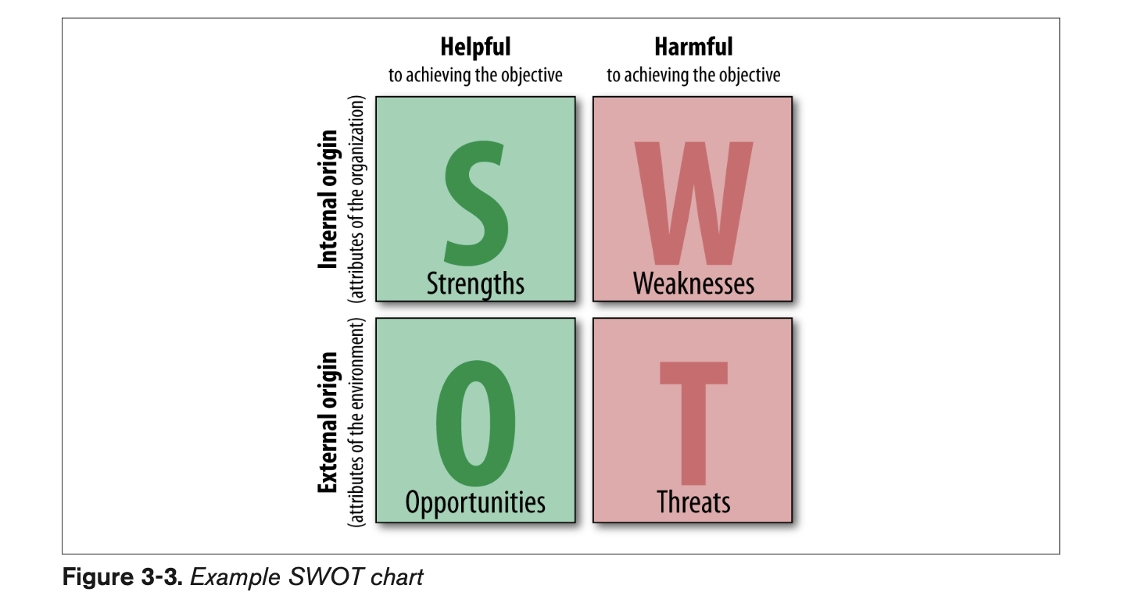
SWOT Analysis (2)

Slide 29
SWOT Analysis (3)
Where does SEO fit in here? To explore this, we’ll use an example.
Take Business X. It has a website that was built on WordPress, makes use of category tagging, adds at least one page of content every two days, and has excellent knowledge of its industry. Its domain name isn’t ideal—Businessnameandkeyword.com—but it is decent.
Business X does not get much traffic from search engines, but its rival, Business Y, does because Business Y has had its website up for a long period of time and received some great links along the way.
Business Y doesn’t have any SEO plan and relies on its main page to bring in all of its search traffic. This is because Business Y has a keyword-rich domain name and people have used those keywords in their links to Business Y’s web- site (giving it keyword-rich anchor text), and because of its longevity on the Web.

Slide 30
SWOT Analysis (4)
There aren’t a lot of target search queries; in fact, there are fewer than 50,000 searches per month for the core set of keywords. Business X’s site ranks on the second page of Google results, whereas Business Y is ranked #3, with Wikipedia and About.com taking up the top two positions.
Neither of the businesses is spending money on PPC (paid search) traffic, and the niche doesn’t have much room for other entrants (there may be 10–15 competitors). Both sites have similar link authority in terms of strengths and numbers.
The businesses deal in impulse purchases; the products evoke strong emotions.

Slide 31
SWOT Analysis (5)
There aren’t a lot of target search queries; in fact, there are fewer than 50,000 searches per month for the core set of keywords. Business X’s site ranks on the second page of Google results, whereas Business Y is ranked #3, with Wikipedia and About.com taking up the top two positions.
Neither of the businesses is spending money on PPC (paid search) traffic, and the niche doesn’t have much room for other entrants (there may be 10–15 competitors). Both sites have similar link authority in terms of strengths and numbers.
The businesses deal in impulse purchases; the products evoke strong emotions.

Slide 32
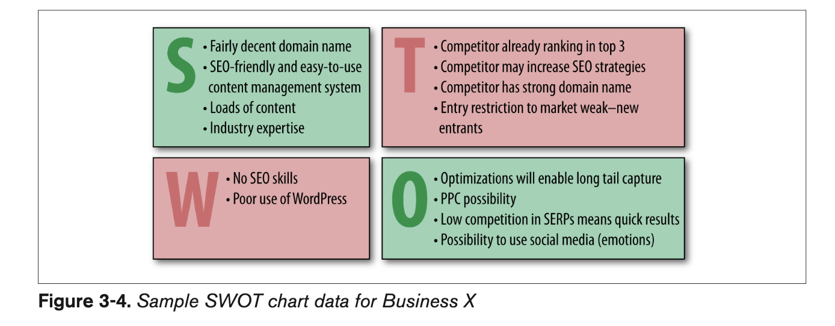
SWOT Analysis (6)

Slide 33
Conclusion
To bring this all together successfully, your objectives, strategies, and tactics need to be aligned, and they need to take into account your market, your business, and the com- petition. Don’t spread yourself too thin. Remember to ask yourself the tough questions, such as:
Does your company need direct sales, traffic, branding, or some combination of these?
Are there specific influencers you’re trying to reach with a message?
Is the organization/brand subject to potentially negative material that needs to be controlled/mitigated?
Do you have products/services you sell, either directly over the Web or through leads established online?
Do you have the resources to develop new, unique, and interesting content?

